Slide 1
Agenda
To understand the major components of Hadoop 1.0 architecture
Name node
Secondary name node
Job Tracker
Task tracker
Data nodes
Notes:
‹#›

Slide 2
Key Terms
Some key terms used while discussing Hadoop
Commodity hardware: PCs which can be used to make a cluster
Cluster/grid: Interconnection of systems in a network
Node: A single instance of a computer
Distributed System: A system composed of multiple autonomous computers that communicate through a computer network
ASF: Apache Software Foundation
HA: High Availability
Hot standby : Uninterrupted failover
Notes:
‹#›

Slide 3
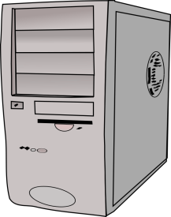
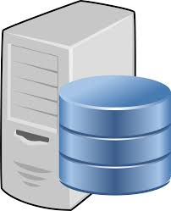

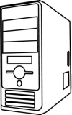
Master-Slave Architecture
Machines in MASTER MODE
Name node
Secondary name node
JOB tracker
Data nodes in slave mode
‹#›
Notes:
‹#›

Slide 4
HADOOP Deployment Modes
HADOOP supports 3 configuration modes when its is implemented on commodity hardware:
Standalone mode : All services run locally on single machine on a single JVM (seldom used)
Pseudo distributed mode : All services run on the same machine but on a different JVM (development and testing purpose)
Fully distributed mode: Each service runs on a seperate hardware (a dedicated server). Used in production setup.
Note: Service here reffers to namenode, secondary name node, job tracker and data node.
‹#›
Notes:
‹#›

Slide 5
Functionality of Each Component of HADOOP
Master nodes
Name node : Central file system manager
Secondary name node : Data backup of name node (not hot standby)
Job tracker : Centralized job scheduler
Slave nodes and deamons/software services
Data node : Machine where files gets stored and processed
Task tracker : A software service which monitors the state of job tracker
Note : Every slave node keeps sending a heart beat signal to the name node once in every 3 seconds to state that its alive. What happens when a data node goes down would be discussed in the subsequent slides.
‹#›
Notes:
‹#›

Slide 6
What is a job in HADOOP eco system?
A job usually is some task submitted by the user to the Hadoop cluster.
The job is in the form of a program or collection of programs (a JAR file) which needs to be executed.
A job would have the following attributes to it
1)The actual program/s
2)Input data to the program (a file or a
collection of files in a directory)
3)The output directory where the results
of execution is collected in a file/s
‹#›
Notes:
‹#›

Slide 7



Apache HADOOP Core Features
Core features of Apache Hadoop are:
HDFS (Hadoop Distributed File System) – data storage
MapReduce Framework – compute in distributed environment
A Java framework responsible for processing jobs in distributed mode
User-defined map phase, which is a parallel, share-nothing processing of input
User-defined reduce phase aggregates of the output of the map phase
‹#›
Notes:
‹#›

Slide 8



Submitting and executing a job in a hadoop cluster
Engineer/analyst
Name node
Job tracker
Gateway
The engineer/analyst's machine is not a part of Hadoop cluster. Usually Hadoop would be installed in pseudo-distributed mode on his/her machine. The job ( program/s ) would be submitted to the gateway machine
The gateway machine would have the necessary configuration to communicate to the name node and job tracker.
Job gets submitted to the name node and eventually job tracker is responsible for scheduling the execution of the job on the data nodes in the cluster.
Data nodes
‹#›
Notes:
‹#›

Slide 9
Summary
An overview of the core components of HADOOP 1.0
Basic understanding of the components namenode, secondary name node, job tracker, data node and task tracker
What is a job in a HADOOP eco system ?
How to submit a job in a HADOOP cluster ?
‹#›
‹#›
‹#›
Notes:
‹#›

